Slide 1

Get GM Working Plan
Data Pack April 2025- DRAFT

Slide 2
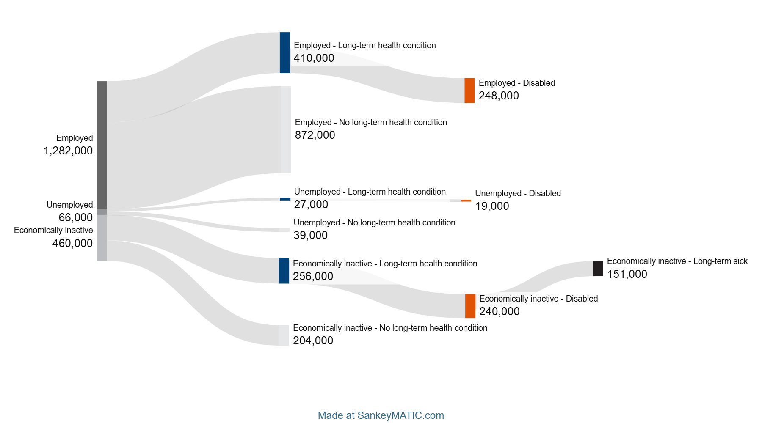
Get GM Working: Labour Market Groups
Data refers to point in time and not flows. Intended to show different labour market groups and respective sizes. Reflects most recent available data as of April 2025.
In GM, about 38% of working age people have a long-term health condition. Of these, just under 60% are in work (this latter proportion is slightly lower than the equivalent UK proportion of 64%).
In GM, there are approximately 256,000 people with a long-term health condition who are out of work and economically inactive. Of these, 151,000 give long-term sickness as the main reason for being inactive.
Figures are rounded for illustrative purposes. Information may include data from slightly different time periods and using different methodologies and draws on a variety of sources.

Slide 3
Economic Inactivity Across Greater Manchester

Slide 4
Economic inactivity in Greater Manchester vs. England (16-64)
Overall, economic inactivity in Greater Manchester for those of working age had been trending downward since 2012 but has seen a recent rise. The rate of economic inactivity in Greater Manchester now sits at 25.0%; previously, in the 12 months to December 2013, the economic inactivity rate peaked at 25.8%.
In recent times, following COVID-19, the rate of economic inactivity did see a slight spike, reaching 24.6% at its peak. Data suggests that the inactivity rate now sits above the peak seen in the pandemic.
While England had seen a slight up-tick in inactivity in the first part of 2024, the trend is not nearly as volatile as in GM and sits markedly below GM levels for inactivity (25.0% in GM vs. 21.1% in England).
Source: NOMIS – Annual Population Survey – Updated quarterly

Slide 5
Economic inactivity by reason: Greater Manchester vs. England
This chart depicts the proportion of the working age population who are economically inactive split by their reason for inactivity and shows how GM figures compare with figures for England. As seen, those who are inactive due to long-term sickness account for 7.9% of the working age population in Greater Manchester, but only 5.7% of the working age population in England – suggesting inactivity due to long-term health conditions is significantly more common in GM than England.
Students also make up a large proportion of the working age population in GM (6.3%) but a smaller proportion of the working age population in England (5.8%). Finally, in GM 4.6% of the working age population are inactive due to ‘looking after family / home’ compared to 4.0% in England.
Source: NOMIS – Annual Population Survey – Updated quarterly

Slide 6
Economic inactivity by age group in Greater Manchester
This chart looks at the economic inactivity rate for age groups in Greater Manchester in the most recent period available.
As seen, 16-24-year-olds are by far the age group with the highest rate of economic inactivity at 45.5%, followed by 50-64-year-olds at 29.7%. The middle age bands, as expected, have the lowest rates of economic inactivity as that’s when people are most likely to be working.
Source: NOMIS – Annual Population Survey – Updated quarterly

Slide 7
Economic inactivity by reason and age in Greater Manchester
This chart depicts the proportional split by age group for each reason for economic inactivity to get a better sense of how age groups vary by reason for inactivity.
As seen, age group proportions vary significantly by reason. For example, 55.4% of all those inactive due to long-term sickness were aged 50+; however, only 28.9% of all those inactive due to looking after family / home were aged 50+. This suggests older age groups are more affected by long-term sickness and that middle age groups are more likely to have the responsibility of looking after the home / family (39.5% of all those inactive due to care responsibilities were 35-49).
Source: Census 2021

Slide 8
Economic inactivity by reason and gender in Greater Manchester
Similar to the previous chart, this chart looks at the proportional split of reasons for inactivity by gender to assess whether certain reasons may be more weighted towards a particular gender.
As seen, the largest disparity in proportional split is seen in those looking after family / home where 82.5% of all those inactive for this reason were female compared to 17.5% male.
Gender disparities are less obvious among other reasons for inactivity; however, it would appear females (55%) also make up a larger proportion of those inactive due to retirement when compared to males (45%).
Other reasons are more evenly split and present limited gender bias.
Source: Census 2021

Slide 9
Economic inactivity in Greater Manchester
In GM, the number of residents who are economically inactive due to ill health stands at 161,500 people, this includes residents who are temporary sick (19,000 people) and long-term sick (142,500 people). 85,500 economically inactive people in GM want a job.
GM has less economically inactive residents due to long term sickness compared to the North- West, but a greater proportion of economically inactive residents due to long-term sickness than England.
To identify where residents who are economically inactive due to ill health or a disability reside, GMCA has created a dashboard bringing together data from a range of sources.
The dashboard can be accessed here.
Notes:
the number economically inactive due to ill health stands at 127,400 people of which 84,300 want a job.
Dashboard

Slide 10
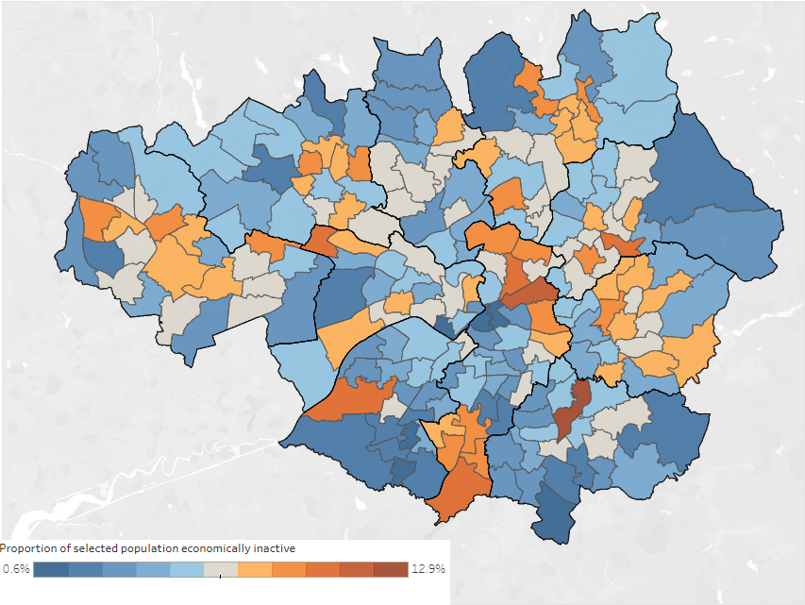
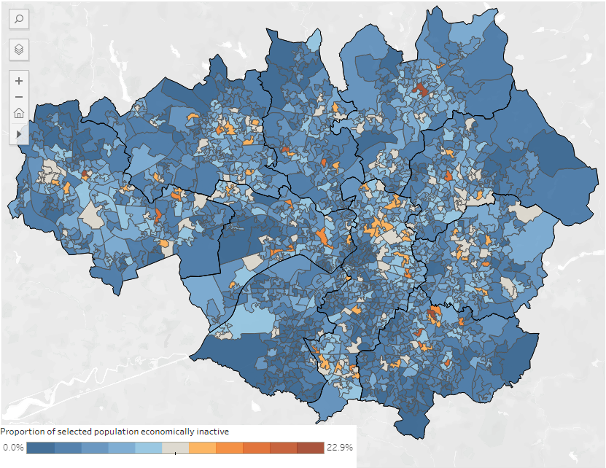
Working age residents who are economically inactive due to long-term sickness or disability (LTSD)
Economic inactivity exists in every borough, ward, and LSOA of GM. However, each geography differs in prevalence (as a proportion – see map on the left). ‘Hotspots’ reside in all boroughs but differ in severity and frequency – this provides an opportunity to identify and target locations with outreach activity.
Ward
LSOA
Manchester has the highest proportion of GM wide economic inactivity due to LTSD at 21.3%, whilst Trafford has the lowest at 5.7%. Manchester has the most hotspots concentrated in the South and East including wards such as Woodhouse Park and Miles Platting. The most prominent hotspot is Brinnington, Stockport (12.9% of the population are economically inactive due to LTSD). Other high prevalence areas include LSOA 016c in Bury, 010c in Rochdale, and 009c in Wigan. Brinnington in Stockport, Harpurhey in Manchester, and Hollinwood in Oldham also have relatively high numbers of Universal Credit claimants on account of health. Funding could be directed to areas with higher levels of economic inactivity due to LTSD.
Notes:
Economic inactivity exists in every borough, ward, and LSOA of GM.
Opportunity to identify and target locations with outreach activity
LA’s differ significantly in rates of EI (Manchester – highest proportions and lots of hotspots)

Slide 11
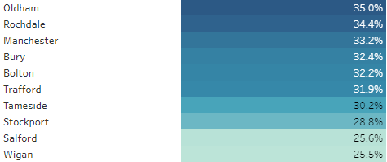
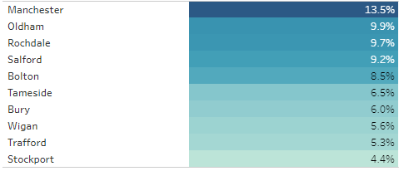
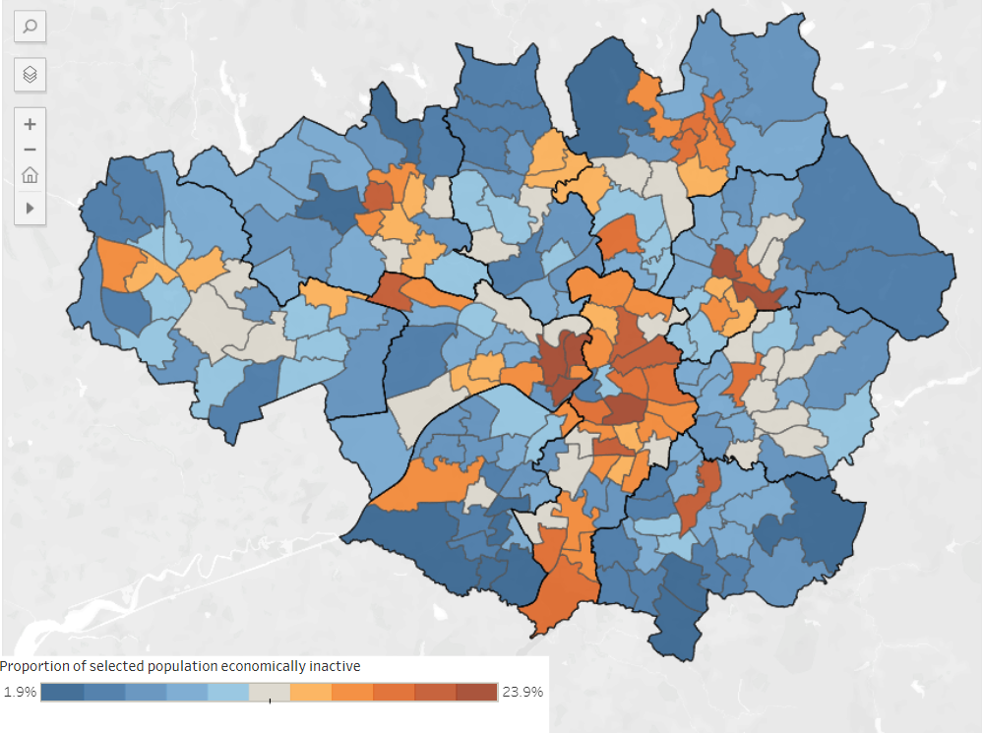
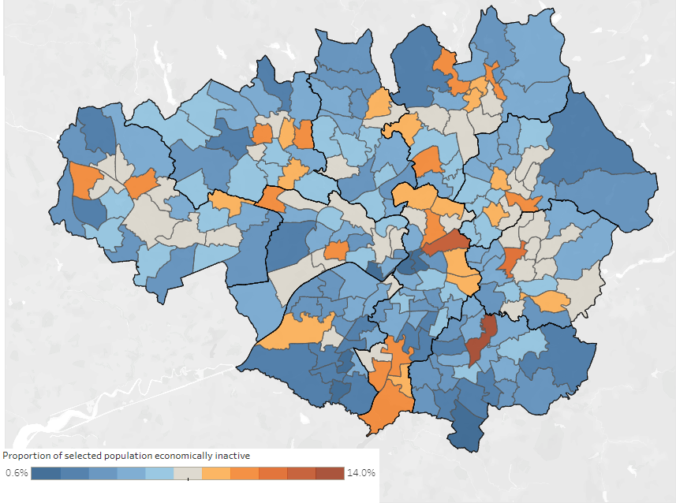
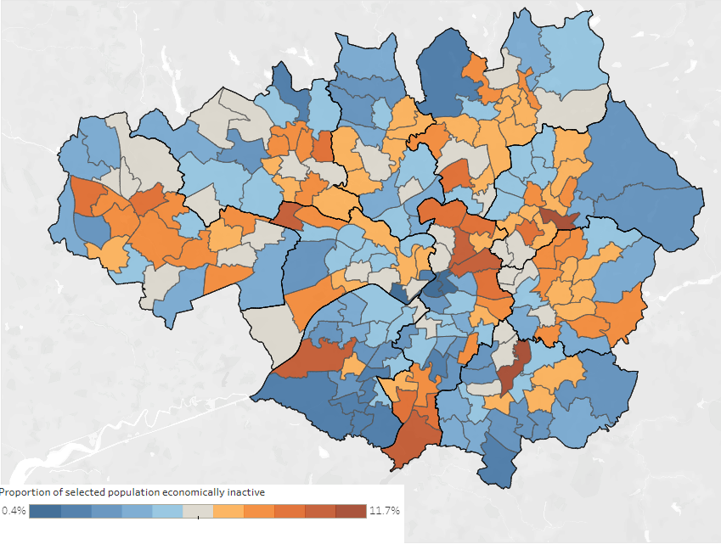
Economic inactivity due to LTSD – gender, age, ethnicity, and length of time out-of-work
Length of time out-of-work is intimately linked to the ability to re-enter work. Young people and women are overrepresented among those who have never worked, with 13.6% of women compared to 10.3% of men. Manchester is a hotspot for women who have never worked (18.4%). Long-term economic inactivity hotspots include Manchester’s northeastern ring, Rochdale, Oldham, and Brinnington in Stockport. High proportions of young people who have never worked are found in Oldham and Rochdale, while over 50s are less affected, except in Manchester (13.5%).
Never worked (16-24-year-olds)
Never worked (50-64-year-olds)
Ethnicity: economic inactivity varies significantly across ethnic groups and localities. The GM white and mixed populations are most likely to be economically inactive due to LTSD. Rochdale has high inactivity for ‘White’ groups (7%), Oldham for ‘mixed’ (7%) and ‘Asian’ or ‘Asian British’ groups (4.7%), and Trafford for ‘Black British’ (4.1%).
Male
Female
Age: levels of economic inactivity due LTSD increase with age. Higher levels are seen among 50-64-year-olds in central Salford, Manchester, and East Manchester. For 16-24-year-olds, Brinnington, Stockport has the highest proportion (6.5%, 123 people). For 50-64-year-olds, Alexandra, Oldham has the highest proportion (23.9%, 490 people). Age-differentiated support may be needed in these areas.
Gender: men and women demonstrate similar likelihood to be economically inactive due to LTSD (51% female vs. 49% male). Men are more geographically dispersed, while women are concentrated in hotspot areas. There is also a significant difference between men and women who have never worked. Targeted support could focus on women’s hotspots whilst accounting for the dispersed nature of male residents.
Notes:
- Length of time out-of-work is intimately linked to the ability to re-enter work
- Young people and women are overrepresented among those who have never worked,
High proportions of young people who have never worked are found in Oldham and Rochdale
Ethnicity and EI vary significantly between groups and locations
Gender – very similar % but very different dispersal
Age - levels of economic inactivity due LTSD increase with age
**Limitation** – we haven’t cross tabulated… 10,000’s of lines of enquiry -> would over confuse and over granulise

Slide 12
Unemployment across Greater Manchester

Slide 13
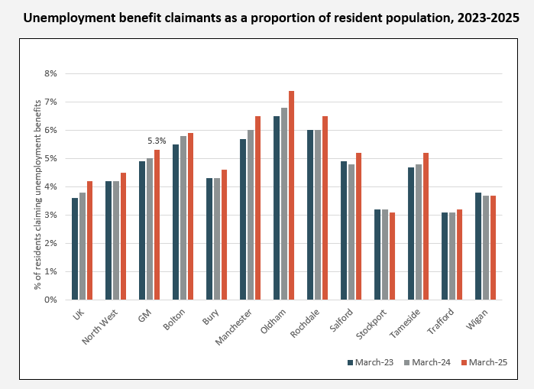
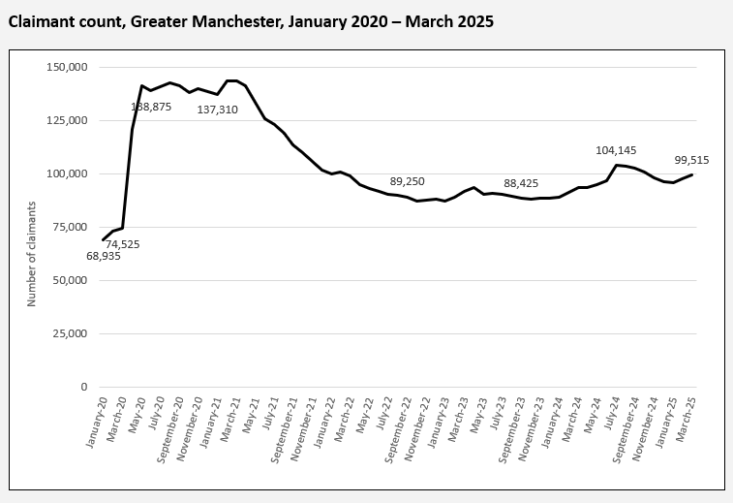
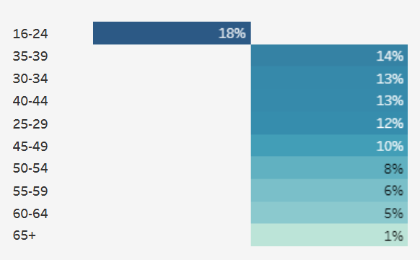
Unemployed - Claimant Count
Age as a proportion of total claims
In March 2025, 5.3% of working-age people in GM were unemployed, with 18% aged 16-24. The Claimant Count spiked during the pandemic and has remained high, with recent data showing a rise again. In March 2024, 99,515 residents were counted, 57% of whom were men.
The areas of GM with the highest prevalence of unemployment benefit claimants are shown in the chart above. In Oldham, 7.4% of residents were in receipt of unemployment related benefits in March 2025.
Breakdowns of Claimant Count data by age and gender are available on the Labour Market and Skills dashboards. There have been significant changes in entitlements and definitions at various points since 1986, which have affected the numbers of people counted. It is therefore debatable whether the Claimant Count more closely reflects the labour market or the welfare regime and policy landscape.
Notes:
The claimant count measures JSA and unemployed Universal Credit (UC) claimants. It does not have the status of a national statistic and is generally viewed as a second-best measure of labour market performance (the LFS was previously preferred but has been subject to concerns about accuracy). On the other hand, it is more timely and more accurate for small geographical areas.

Slide 14

Claimant count rises across all ten GM local authorities
Claimant count, UK, NW, GM and LAs, February 2025 – March 2025
Area | Feb-25 | Mar-25 | % change
UK | 1,750,620 | 1,778,055 | 1.6%
North West | 208,950 | 211,700 | 1.3%
GM | 97,830 | 99,515 | 1.7%
Bolton | 10,850 | 10,930 | 0.7%
Bury | 5,445 | 5,570 | 2.3%
Manchester | 26,165 | 26,850 | 2.6%
Oldham | 10,995 | 11,150 | 1.4%
Rochdale | 9,055 | 9,220 | 1.8%
Salford | 9,700 | 10,025 | 3.4%
Stockport | 5,590 | 5,595 | 0.1%
Tameside | 7,570 | 7,605 | 0.5%
Trafford | 4,650 | 4,690 | 0.9%
Wigan | 7,805 | 7,880 | 1.0%
The claimant count in Greater Manchester rose by 1.7% between February and March 2025 - to 99,515 claimants. The rise in GM was slightly larger than both the North West (1.3%) and the UK (1.6%).
The claimant count saw rises in all ten LAs, though these rises were uneven across GM. Salford (3.4%), Manchester (2.6%) and Bury (2.3%) saw the largest proportional increases, whilst Bolton, Stockport, Tameside and Trafford all saw rises of less than 1%.
Note: The latest month’s data is typically revised downwards slightly in the following month.
Source: ONS

Slide 15
Unemployed – Labour Force/Annual Population Survey
The survey measure of unemployment shows about 30,000 fewer unemployed people than the Claimant Count. Unlike the Claimant Count, it doesn’t reflect the sharp rise in 2020 or the recent slow increase. At the end of 2024, the unemployment rate was 4.9%.
Area | % unemployed (16+)
GM | 4.9
Bolton | 6.4
Bury | 3
Manchester | 9.2
Oldham | 4
Rochdale | 4
Salford | 3.7
Stockport | 3.5
Tameside | 4.2
Trafford | 2.5
Wigan | 3
UK | 3.8
The unemployment rate has been well above 10% in several districts at various points (such as after the financial crisis), but more recently has been comparatively subdued compared to inactivity. Minority ethnic residents typically have higher unemployment rates. At the end of 2024, the unemployment rate for minority ethnic residents was 9.5%, compared to 3.8% overall. Please note that there is considerable volatility with ethnic minority unemployment data so should be treated with caution.

Slide 16
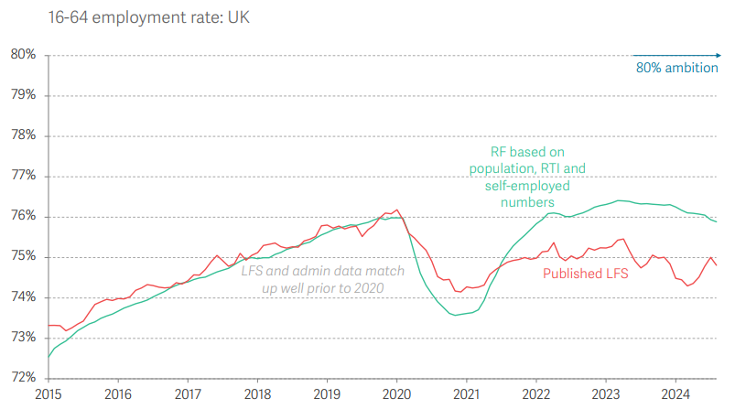
Cautionary Note: Labour Force Survey
The Resolution Foundation released a new paper in November 2024 which makes the case that the data used to estimate the 3 components of the labour market data - employment, unemployment, and economic inactivity - is significantly unreliable. It has some pretty stark implications - I've tried to distil it here after a quick read through:
LFS Issues - it starts by highlighting issues with the Labour Force Survey - which the ONS has flagged a number of times recently itself:
  The response rates have collapsed from 39% in 2019 to 13% in 2023.
  Given this drop, there's likely a response bias where employed people are less likely to complete the survey, resulting in the unemployed and inactive being over-represented.
  There's likely an error in population estimates - the denominator for calculating labour market statistics.
Alternative Administrative Data - it creates a separate measure (using HMRC RTI payroll data and self-employment records) - a comparison of the rates for 16-64 are below
National Implications - If the employment rate is higher than projected, one of unemployment or inactivity must be lower than thought. It suggests the likelihood is that most of the discrepancy is in inactivity (due to scale of those groups). As a result - 80% target may be closer than thought - and inactivity may not be as much of an issue as thought.
  Another disturbing implication is that productivity growth is much weaker than thought - if the overall size of the economy is barely growing despite employment rate growing.
GM Implications - Not clear how much we can take from this and apply to GM. However, if the general trend is right, GM's 80% employment rate may require fewer than 150,000 people. And if the lower unemployment rate is correct and there are fewer inactive people to target, it raises the importance of health interventions for those long-term sick - one of the components we can be fairly certain on.
It's not clear what the ONS response to this will be - they've been working on a "Transformed" Labour Force Survey which is yet to be released, and have been adding caveats to everything they've released recently. Lot of uncertainty to add into the picture, and clearly policymaking is a harder without accurate data.

Slide 17
Multiple Disadvantage Across Greater Manchester

Slide 18
People experiencing multiple disadvantage
Offenders/ex-offenders: GM Police recorded 36,202 arrests between 2020-2021 – some of the most prevalent issues/needs amongst these people include alcohol and drug dependencies and accommodation issues.
Veterans: according to the 2021 census, there are over 50,000 ex-service personnel in GM that served in the UK regular armed forces, and just under 15,000 who served in the reserve forces. Wigan is home to 7,818 ex-regular armed forces personnel, by far the highest (and much larger than Wigan’s proportionate population in GM). Wigan falls to second place when it comes to ex-reserve armed forces.
LA | Previously served in UK regular armed forces | Previously served in UK reserve armed forces | Previously served in both regular and reserve UK armed forces
Bolton | 5566 | 1523 | 262
Bury | 3756 | 1115 | 213
Manchester | 5111 | 2298 | 315
Oldham | 4500 | 1213 | 225
Rochdale | 4408 | 1077 | 248
Salford | 4391 | 1400 | 241
Stockport | 5900 | 1759 | 350
Tameside | 5091 | 1330 | 278
Trafford | 3798 | 1351 | 195
Wigan | 7818 | 1914 | 402
GM | 50339 | 14980 | 2729
Domestic abuse: 92,000 people in GM have experienced domestic abuse, with 78,000 experiencing it in the previous 12 months (March 2018). 20,000 had used alcohol problematically, with over 20,000 experiencing homelessness at some point.
Substance abuse: there are 70,000 people in GM who are drug dependent. 21,000 are in treatment and of these, 2,500 have a chronic housing need, 1,500 have a housing problem, and 1,200 have a criminal justice referral.
Carers: according to 2021 census data, there are 76,078 carers providing over 50 hours of unpaid care a week in GM. Over 55,000 provide between 20 to 49 hours a week. Manchester and Wigan have the highest number of carers providing 50+ hours a week of unpaid care, with the fewest in Bury and Trafford.
LA | All | EET | NEET | No Info
Bolton | 366 | 163 | 122 | 71
Bury | 267 | 82 | 87 | 98
Manchester | 1396 | 812 | 309 | 275
Oldham | 374 | 141 | 128 | 105
Rochdale | 384 | 168 | 109 | 107
Salford | 487 | 303 | 148 | 36
Stockport | 319 | 150 | 113 | 56
Tameside | 499 | 220 | 204 | 75
Trafford | 315 | 119 | 90 | 106
Wigan | 363 | 123 | 111 | 129
GM | 4770 | 2281 | 1421 | 1058
LA | Provides 19 hours or less unpaid care a week | Provides 20 to 49 hours unpaid care a week | Provides 50 or more hours unpaid care a week
Bolton | 11474 | 5899 | 8600
Bury | 8134 | 3643 | 5094
Manchester | 15630 | 10398 | 12190
Oldham | 8737 | 5080 | 6871
Rochdale | 8214 | 4702 | 6492
Salford | 8893 | 4946 | 7052
Stockport | 13757 | 4968 | 7474
Tameside | 9283 | 4666 | 6720
Trafford | 10057 | 3680 | 5087
Wigan | 13929 | 7055 | 10498
GM | 108108 | 55037 | 76078
Homelessness: over 6,500 households in GM owed a prevention duty, relief duty, or main duty across the quarter ending December 2023. Nearly 5,000 households were in temporary accommodation at the end of December 2023. Across the month of May, 337 people were experiencing rough sleeping in GM.
Care leavers – aged 17-24: in GM, there are 4,770 care leavers (i.e. those with care experience) between the ages of 17-24, of which 1,421 are NEET (not in employment, education or training). Manchester has by far the highest number of care leavers at 1,396, accounting for nearly 30% of 17-24-year-old care leavers.

Slide 19
16-24 NEETs in Greater Manchester

Slide 20
16-24 NEETs
The concept of NEETS – not in employment, education or training – theoretically runs to the age of 24. However, owing to better data, NEETs are typically discussed only at the ages of 16 and 17 because of local authority statutory responsibilities.
The government does publish information on NEETs for the wider age range with detailed sub-national geographical breakdowns. In the UK, 11.9% of 16–24-year-olds were NEET in 2023. No regional or sub-regional data breakdowns were provided. The data is available here.
Research into NEET young people has suggested NEET rates in that vary. Research from Impetus in 2019 suggested NEET young people constituted 16% of 18–24-year-olds in GM (see here). GMCA research into 16–24-year-olds found a rate of 13.1% in the conurbation in 2019 (available on request). The key point is that disadvantage and poverty profoundly shape the rates of NEET; neighbouring areas can have widely varying NEET rates.
Key issues identified in the research include sickness and caring responsibilities accounting for large proportions of NEET. Also, largescale monthly churn.
However, arguably the concept of NEET overlaps greatly with unemployment and inactivity – standard labour market categories among all ages. After all, most of this age cohort are technically adults. There is a case therefore for monitoring age specific cohorts of inactive and unemployed.

Slide 21
Employment rate among young people edged lower over recent decades
GM 16-24 employed slightly below national patterns – as with employment rate 16-64. Learning for longer is likely part of the explanation (see next slide).
Source: Annual Population Survey

Slide 22
Pay in Greater Manchester (2024 data)

Slide 23
Pay: summary
Key points from UK-level wages information
Nominal regular pay (excluding bonuses) in the three-month period between November 2024 and January 2025 increased by 5.9% compared with the same period in the previous year, according to data released on the 20th March 2025.
After inflation adjustments, real pay increased by 2.2% (using the CPIH measure of inflation which includes housing costs). This means employees should feel some benefits from increases in nominal pay.
Pay increases in the public sector were reported at 5.3%; and 6.1% in the private sector.
The sector which experienced the fastest pay growth was wholesale, retailing, hotels and restaurants (6.3%). This was followed by the construction sector (6.2%).
Average weekly earnings for regular pay were estimated at £667 for the UK in January 2024.

Slide 24
Key messages
Real pay rises, but in context remains limited: After a decade of lost growth in ‘real’ (inflation-adjusted) pay between 2009-2020, median hourly pay in GM has finally started to see notable increases for employees in GM and the UK. However, these increases are still very small in reality when compared to wages in 2008. In 2008, the median worker in GM earned £15.52 an hour (adjusted for today’s inflation); in 2024 this was £16.78. After sixteen years, the median worker in GM is only seeing £1.26 more per hour in their pay – or 8p every year. Since 2020, GM has shown strong pay growth, performing considerably better than comparator areas in London, Liverpool and the West Midlands.
The importance of place; residents do not always reap the rewards: There are two ways of measuring earnings: residence or workplace-based pay. Resident pay measures the median pay of those who live in an area, whilst workplace pay measures the pay of those who work in an area. For most places in GM, those who live in an area tend to earn more than those who work in an area. Two very notable exceptions to the rule are Manchester and Salford, where the typical worker in Manchester and Salford earns more than residents. Commuter patterns are very likely to explain these trends, where residents of ‘wealthier’ areas of GM (such as Trafford and Stockport), or areas outside of GM, travel into the city centre for high-paying jobs. Meanwhile, residents of these areas see lower pay than the GM and national averages. Economic opportunities are growing, but these are not always enjoyed by the local population.
Median pay by gender and hours remains broadly unchanged: The gap between male and female hourly pay has remained fairly stable since 2008 with minor fluctuations. Annual pay, on the other hand, has seen some significant variation. Dips in the median male annual salary were observed around 2010, 2014 and most significantly in 2021, whilst no such dips occurred with median female annual salaries apart from a slight flatline in 2021. Some of the difference in median hourly pay may be explained by differing working patterns. When it comes to part-time work, women tend to be paid more than their male counterparts, with the exception of Salford and Stockport.
Gender pay gap is closing: The gender pay gap has decreased from 2023 and 2024, for both residence and workplace-based pay, and across both GM and the UK. Bury (19.7%), Stockport (19.3%) and Trafford (15.6%) all have the highest workplace gender pay gaps in GM, whilst Oldham (0.6%) and Rochdale (1.4%) have the lowest workplace gender pay gaps in GM.
Increased prevalence of low pay: 2024 data showed that the proportion (and number) of employees paid below the real living wage (RLW) had increased to 16.2% after a historic low of 12.9% in 2022. Approximately 193,000 employees in Greater Manchester were in low-paid work in 2024. There could be various explanations behind the reversal of recent trends (where low pay had been falling or flat for consecutive years); one explanation could be due to recent large increases in the RLW rate and national minimum wage, meaning employers have not been able to keep pace with RLW uplifts.

Slide 25
Summary: Median pay in Greater Manchester, 2024
Median pay for employees who live in Greater Manchester was £16.57 per hour in 2024.
Median pay for employees who work in Greater Manchester was £16.78 per hour in 2024.
Pay tends to be slightly higher for people who work in GM (some of whom commute in) than for residents. The workplace-resident pay gap is especially prominent in areas containing the regional centre such as Manchester and Salford.
Pay is generally lower than the national average in the GM city region. For example, for each hour they work, employees who work in GM earned on average 31p less per hour than the average nationally in 2024. This is a smaller difference than in 2023 (a 58p average hourly gap).
Note: All data referring to 2024 are provisional in this presentation. 2023 is revised data. New ASHE data was released by the ONS on 29th October 2024.

Slide 26
Final thoughts
GM in relation to the UK and other areas: GM trails the UK and London in terms of average pay, both by residence and workplace (though workplaces fare slightly better). GM also trails the national average in terms of low pay. However, the major story since 2008 is the relatively strong growth seen in GM hourly and annual pay, especially in workplaces in the city region. GM has seen strong pay growth since 2020, overtaking the likes of Liverpool and the West Midlands. Unlike the capital, real terms pay has now risen to above-2008 levels
Importance of place: pay can vary significantly across districts based on whether our definition is of place of work or residence (e.g. Manchester and Salford)
The effects of inflation: although pay (hourly) has now managed to rise above 2008-levels, the increase is ultimately very small. There was a lost decade of real-terms pay growth between 2009-2020 that has significantly impacted on the incomes and opportunities of those working and living in GM (and indeed the rest of the country)
The nuance of the gender pay gap: we know there is a gender pay gap, but the geographical distribution of gender pay gaps, and the types of jobs where there are differences, might be of greater interest. Women are typically paid more in part-time jobs compared to men, but are paid significantly less when it comes to full-time jobs. The gender pay gap is more pronounced in places with higher pay, suggesting a trade-off between low pay and low inequality.

Slide 27
Vacancy rate and employment demand

Slide 28
Job postings rise in March 2025
Monthly job vacancy postings, Greater Manchester, January 2020 to March 2025
The latest job posting figures from Lightcast for March 2025 showed an increase from February. However, job vacancies have fallen considerably since their peak in early 2023.
Job postings in the month of March have not been this low since 2021, suggesting that demand for staff has significantly reduced on recent years.
Note: The latest month’s data is typically revised slightly in the following month.
Source: Lightcast
Notes: Lightcast is a system enabling the monitoring of online job vacancies.

Slide 29
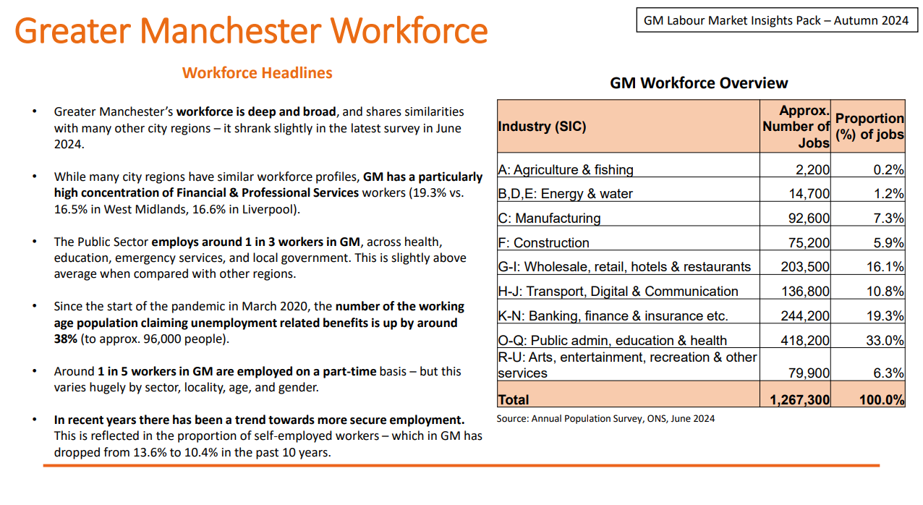

Slide 30
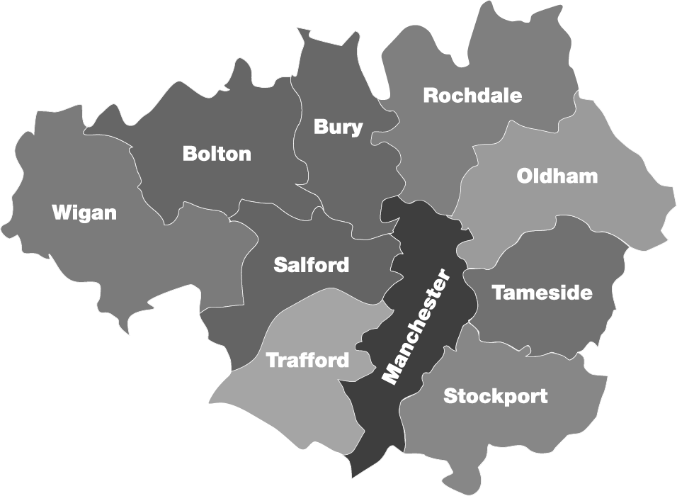
GM in-demand occupations (Jun 2024 – Aug 2024)
GM Labour Market Insights Pack – Autumn 2024
  Teaching Assistant
  Social Worker
  Nurse
  Admin Assistant
  Carer
  Teaching Assistant
  Admin Assistant
  Cleaner
  Truck Driver
  Retail Sales
  Admin Assistant
  Teaching Assistant
  Cleaner
  Nurse
  Truck Driver
  Teaching Assistant
  Cleaner
  Admin Assistant
  Nurse
  Carer
  Teaching Assistant
  Social Worker
  Teacher
  Admin Assistant
  Cleaner
  Teaching Assistant
  Social Worker
  Admin Assistant
  Nurse
  Carer
  Teaching Assistant
  Admin Assistant
  Nurse
  Cleaner
  Bookkeeper
  Teaching Assistant
  Cleaner
  Admin Assistant
  Nurse
  Customer Service
  Cleaner
  Admin Assistant
  Sales Representative
  Teaching Assistant
  Childcare Teacher
  Lawyer
  Salesperson
  Software Developer
  Admin Assistant
  Teaching assistant
Source: Lightcast
Notes: Lightcast is a system enabling the monitoring of online job vacancies.
(Changes shown vs. previous 3 months)

Slide 31
Source: Lightcast
Notes: Lightcast is a system enabling the monitoring of online job vacancies.

Slide 32
Higher than Jan 2020
Digital
Hospitality
Overall vacancy levels are now below pre-pandemic levels – 2024 consistent decline.
Hospitality - volatile job postings but remain high.
Public sector – Education, H&SC still fairly high vacancy levels.
High-pay high-skill sectors – FBPS, Digital both well below Jan 2020 levels.
Education
H&SC
Manufacturing
ALL
FBPS
Source: Lightcast
Notes: Lightcast is a system enabling the monitoring of online job vacancies.

Slide 33
April 2025 NMW for 40-hr FT workers – £25,396 pa.
Source: Lightcast
Notes: Lightcast is a system enabling the monitoring of online job vacancies.

Slide 34
What are the needs and what support is required?

Slide 35
Greater Manchester ill-health and disability claimants: All ages
Trends in Greater Manchester health and disability claimants based on estimates suggest that we are seeing record highs in health claimants since Feb-13, increasing at a sharp rate.
Health claimants are now estimated to have peaked in May-24 at 195,043 claimants, reaching a previous peak of 176,918 claimants in Feb-15. This was then followed by a period of decline to a low of 158,804 claimants in Feb-20 – around the time of COVID. Therefore, post-COVID, health claimants in Greater Manchester have risen significantly, increasing by over 35,000 in the 4 years to May-24.
Currently, the estimated 195,043 health claimants make up 36.4% of total working age claimants in GM and 10.8% of the total working age population in GM.
Note: it is important to be aware that this figure excludes claimants of UC NWR, making this figure at an least and not a maximum.
Source: Stat-Xplore – Benefit Combinations Dataset – Updated quarterly (over 6-month lag)

Slide 36
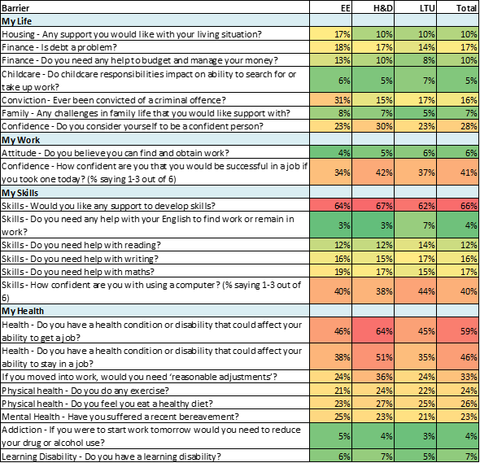
Needs analysis – what do people experience?
Working Well: Work & Health Programme barriers to work
Note: EE = multiple disadvantage group, H&D = health & disability, and LTU = long-term unemployed
Participants on Working Well programmes face diverse barriers and needs, requiring varied support:
Long-term unemployed participants are much less likely to move into work, so may require more intensive support. Working Well: Pioneer participants (economically inactive) are more qualified and confident in their ability to start work than the long-term unemployed. This may be due to the outreach element of the programme and its impact on motivation to work.
Common barriers experienced across all programmes are health, skills, and confidence. Additional health support and a specific skills offer through AEB may be beneficial.
Wider issues including (but not limited to) housing, finance, previous convictions, bereavement, and caring are also prevalent, and more likely to be experienced by priority groups (those experiencing multiple disadvantages).
Participants on current programmes (IPSPC, Pioneer and current WHP [post-September 23]) are much more likely to be short-term unemployed than previously seen on WHP/other programmes, suggesting they are closer to the labour market.
Those who are in-work tend to have greater health issues and issues around family life whilst out-of-work cohorts still have high levels of health issues but are more likely to experience issues relating to work experience, skills, transport, and wider barriers.
For those in-work, experiences of their work are often a contributing factor to poor health in terms of overwork, bullying/harassment, working conditions, and job quality/security.
Oral health is an issue across all programmes, suggesting the need for the continuation of Working Well: Roots to Dental.

Slide 37
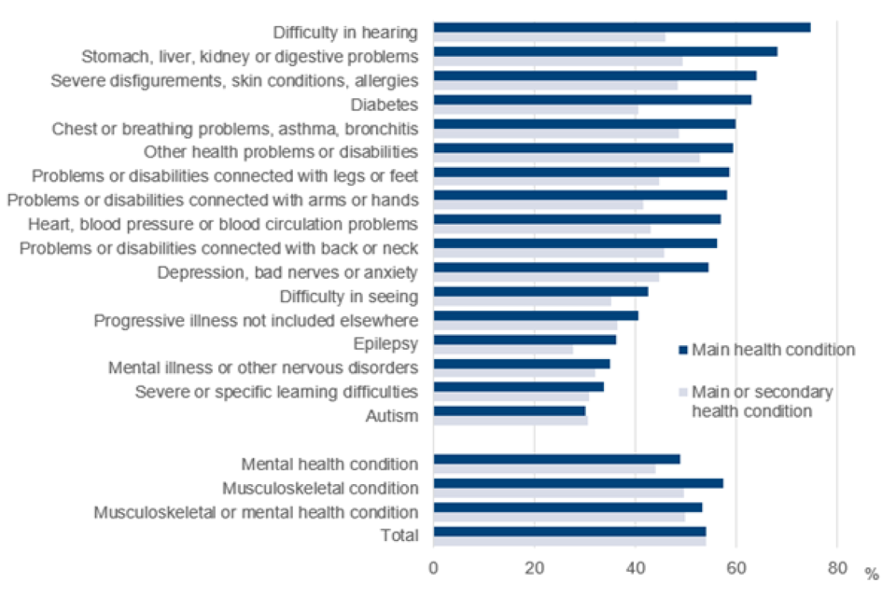
Type of health condition
Type of health condition can affect the likelihood of employment. For example, those with hearing loss are twice as likely to be employed compared to those with Autism. Disabled people with musculoskeletal issues are more likely than those with a mental health condition to be in employment. Autism, severe learning difficulties, or severe mental illness, are least likely to be in employment. Therefore, provision will require employing specialist staff with knowledge of supporting people with certain health conditions with individualised approaches: more intensive support may be more suitable for neurodivergent individuals, whereas moderate intensive support may be more suitable for people with musculoskeletal issues or less complex mental health needs.
Integrated or directly delivered health interventions specific to people's needs are essential.
Health condition
Employment rate
Data held by Working Well programmes highlight that the most prevalent health conditions or disabilities for GM residents accessing the services are psychiatric disorders, such as depression, low mood, or anxiety, with musculoskeletal problems the second most prevalent condition. This information correlates with a national picture where research has found the main reasons for economic inactivity due to LTSD are mental ill health and musculoskeletal issues.

Slide 38

Econometric profiling
Working Well annual report (2021) included econometric (complex regression) analysis of WW participant data, identifying key factors that determine ‘job start likelihood’.
Attributes with greatest affect are:
Age
Length of unemployment
Confidence
Engagement
  Job start likelihood decreases with age, from nearly 40% for 20-year-olds to around 20% for 60-year-olds.
  Those unemployed for 0-6 months are most likely to start a job (49.7%), with likelihood decreasing the longer they are out of work, down to 13.6% for over 10 years.
  Highly confident clients (score of 6/6) are more likely to start a job (36.7%) compared to the least confident (14.7%).
  Higher engagement with the service increases job start likelihood, from around 35% for fully engaged clients to a few percentage points for those barely engaged.
Other attributes that contribute include:
Low qualifications
Low digital skills
Caring responsibilities
Poor health
Number of health conditions
Debt
Whether you exercise
No driving license

